Slide 1
EDA Analysis
Introduction
Content of the data frame
Looking deeply into the data
Data Comparing
Presenting with nice graphs

Slide 2
Introduction to Data Analysis
It's one of the adults data
To know what's the size of the data and how many features are in the dataset
From this data we can get to know how peoples are leaving in the country
And how they are earning
And what kind of relationships in-between of them
How data is distributed
And what data we can extract from this dataset
How data is dependent on each features
Finally represent with good analytics by nice graph.

Slide 3
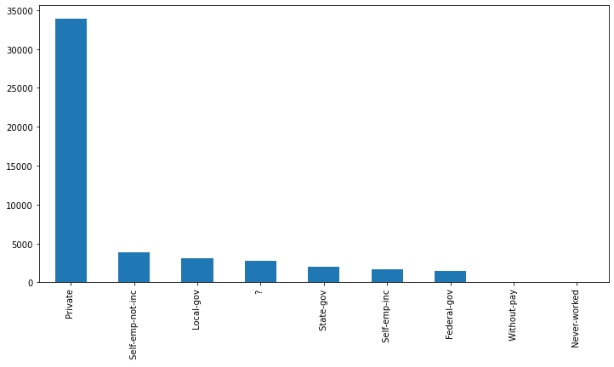
Content of the data frame
Private 33906 Self-emp-not-inc 3862 Local-gov 3136 ? 2799 State-gov 1981 Self-emp-inc 1695 Federal-gov 1432 Without-pay 21 Never-worked 10
Most of the people working in private sector.
Very less in federal govt
Total 21 peoples are working but free and also 10 people are never worked till.
How many peoples are working in different domines

Slide 4
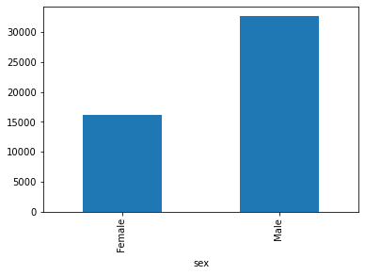
Content of the data frame
More then '32,000 peoples are males' and
More then '16000 peoples are females' in the dataset¶

Slide 5
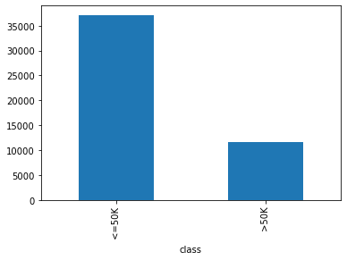
Content of the data frame
Total 11687 people that is 23.9% of peoples are earning greater then 50k per month.
Total 37155 people that is 76% of peoples are earning less then 50k per month.

Slide 6
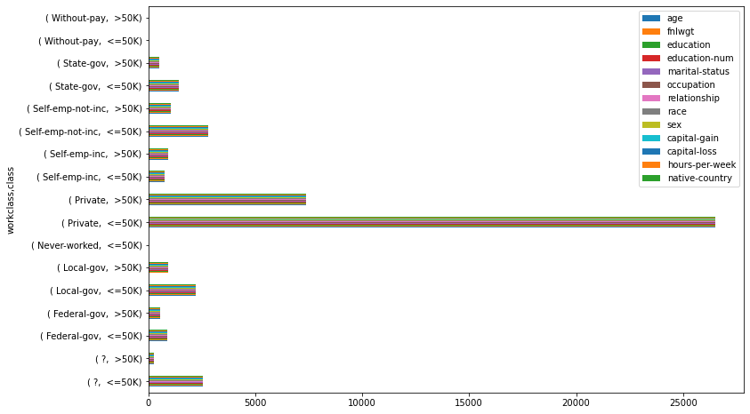
Looking deeply into the data
Private <=50K 26519 people, >50K 7387 people, almost 21% of people making more mony
Most of the people working in private secter and also most of them earning more then 50K from that
In Federal-gov <=50K 871 people, >50K 561 people, almost 39% of the peoples are making more mony
Self-emp-inc <=50K 757 people, >50K 938 people 55% of people making more mony
Self-emp-not-inc <=50K 2785 people, >50K 1077 people 27% of people making more mony
Local-gov <=50K 2209 people, >50K 927 people, 29% of people making mony

Slide 7
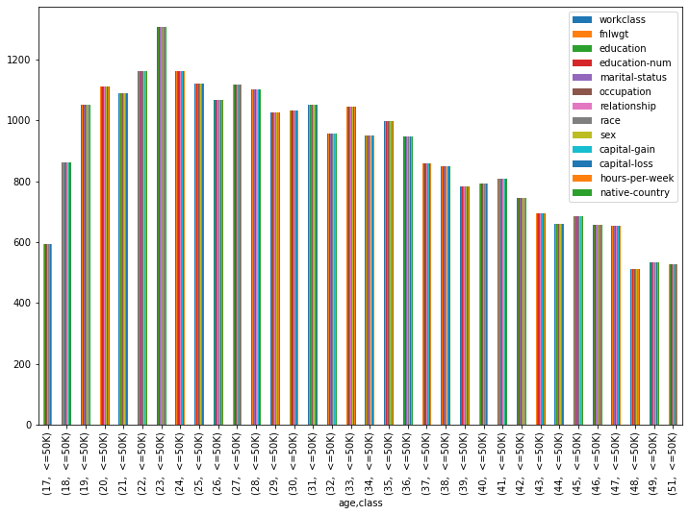
Looking deeply into the data
More then 30500 Peoples are getting less then 50k in the hole dataset
The almost age of '17 to 51' all are getting less then 50k amount in the data set

Slide 8
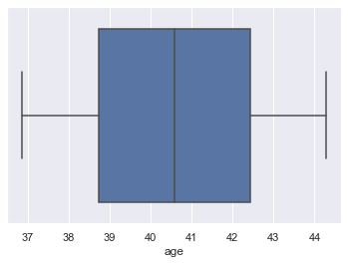
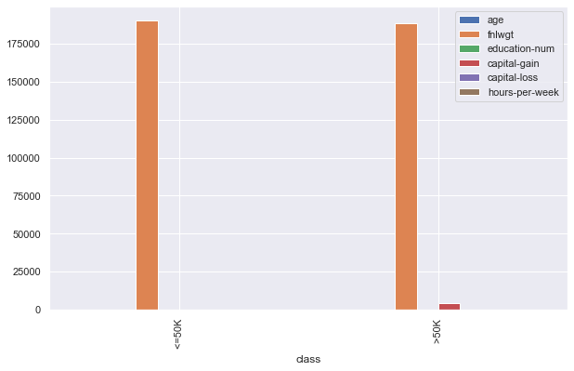
Data Comparing
Here 36.87% of data is less then 50k
here 44.27% of data is greater then 50k

Slide 9
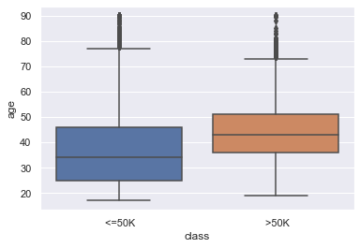
Data Comparing
So here we can easily understand from this graph is
Most of the people in the age of 25 to 47 aged peoples are getting less then 50k
At the same time leest nuumber of peoples are getting more then 50k
Age 35 to 52aged peoples are getting more then 50k

Slide 10
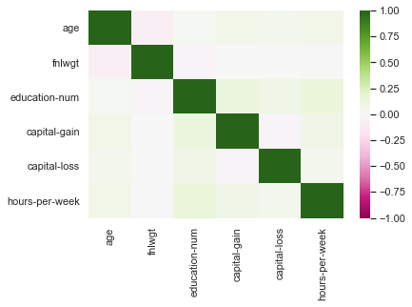
Presenting with nice graphs
Here we can easily know as
The dark green indicates is heavily correlated
And thick pink is the no correlation
And light pink is the lightly correlation with the data

Slide 11
Conclusion
Many people are working in private sector but also they are getting less mony and very few peoples are getting more then 50k
Most of Woh are completed 'Masters and Doctorate' those peoples are usually getting more then 50k
HS_grad total 15784 people are there in that 13281peoples are getting less then 50k per month.
Whos age is more those people are gatting more mony compare to less aged people
Finally coming to the correlation there is very less correlation almost all are equal to zero only

Slide 12
Thank you

